Slide 1
The relational model
Relational databases

Slide 2
Aim
Look at the background to relational model and its evolution
Principles of RDBMS
Advantages of RDBMS
Limitations if RDBMS

Slide 3
Background to relational model
Previous data systems were hierarchical or network model
Data sharing limited
Data extraction complex and flawed
Application specific
Became not fit for purpose once computing systems started to take off

Slide 4
Terminology used
Attribute – properties within the table
Relational schema – schema or map that represents the name of the relation (table) with attributes and interactions
Tuple – row
Cardinality – number of tuples in a relation (how many rows are in the table)
Column – represents the set of values for an attribute
Constraints – limitations for the data set can be tuple or relation based.
Referential integrity – when one attribute in a relation/table can only take value from another attribute in a relation/table

Slide 5
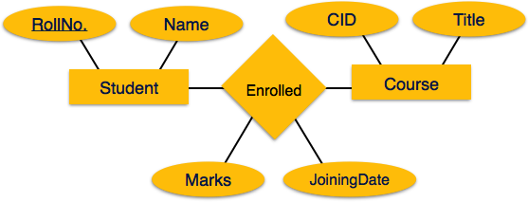
Relational model
Proposed by E F Codd
Models data in form of relationships between data sets using a relationship diagram
Models the behaviour and relationships of data
Simplistic
Relational datastores (tables)
Set mathematics
No duplication
Order not relevant

Slide 6
Relational model – Codd’s rules
Rule 1: Information Rule
The data stored in a database, may it be user data or metadata, must be a value of some table cell
Rule 2: Guaranteed Access Rule
Every single data element (value) is guaranteed to be accessible logically with a combination of table-name, primary-key (row value), and attribute-name (column value). No other means, such as pointers, can be used to access data.
Rule 3: Systematic Treatment of NULL Values
The NULL values in a database must be given a systematic and uniform treatment. This is a very important rule because a NULL can be interpreted as one the following − data is missing, data is not known, or data is not applicable.
Rule 4: Active Online Catalogue
The structure description of the entire database must be stored in an online catalog, known as data dictionary.
Rule 5: Comprehensive Data Sub-Language Rule
A database can only be accessed using a language having linear syntax that supports data definition, data manipulation, and transaction management operations. This language can be used directly or by means of some application. If the database allows access to data without any help of this language, then it is considered as a violation.

Slide 7
Codd rules
Rule 6: View Updating Rule
All the views of a database, which can theoretically be updated, must also be updatable by the system.
Rule 7: High-Level Insert, Update, and Delete Rule
A database must support high-level insertion, updation, and deletion. This must not be limited to a single row, that is, it must also support union, intersection and minus operations to yield sets of data records.
Rule 8: Physical Data Independence
The data stored in a database must be independent of the applications that access the database. Any change in the physical structure of a database must not have any impact on how the data is being accessed by external applications.
Rule 9: Logical Data Independence
The logical data in a database must be independent of its user’s view (application). Any change in logical data must not affect the applications using it. For example, if two tables are merged or one is split into two different tables, there should be no impact or change on the user application. This is one of the most difficult rule to apply.

Slide 8
Codd rules
Rule 10: Integrity Independence
A database must be independent of the application that uses it. All its integrity constraints can be independently modified without the need of any change in the application. This rule makes a database independent of the front-end application and its interface.
Rule 11: Distribution Independence
The end-user must not be able to see that the data is distributed over various locations. Users should always get the impression that the data is located at one site only. This rule has been regarded as the foundation of distributed database systems.
Rule 12: Non-Subversion Rule
If a system has an interface that provides access to low-level records, then the interface must not be able to subvert the system and bypass security and integrity constraints.

Slide 9
Advantages
Flexible
Data access granularity
Shareability of data between applications
No data duplication
Standardised language for access
Better security
Future proofing

Slide 10
Limitations
Never able to be fully realised
Rules not enforced so inexperienced developers can generate flawed systems
Performance issues

